Slide 1


BT Bootcamp Mock Project Case Study
Prepared for ABC Pharma
2025

Slide 2
Introduction
Pharma ABC was established in 1964 and is headquartered at New York
Pharma ABC is well known for key innovations and always introduces drugs in new markets; it has launched 25 drugs so far of which 7 are block busters
Keeping up with the latest technology, the management has recently installed a new IT system to solve few business use cases
There are multiple teams working in the company which need access to certain reports to better plan and execute their functions
ZS team worked closely with these internal teams to identify their reporting needs
As a next step, client has decided to seek your help in using the existing system to generate the four reports
The drugs are sold by pharma companies to wholesalers who further sell the products to pharmacies and hospitals. Some pharmacies and large hospitals may buy drugs directly from the pharma company.

Slide 3
Introduction (cont.)
The pharmacies dispense a drug when a patient visits them with a valid prescription. A prescription filled for the first time is called a New Prescription (NRx) and if it is refilled it counts towards Total Prescriptions (TRx).
Patients in the US typically have health coverage through an insurance plan. Related to insurance plan, two entities are important – Plan provider and Payer.
There are two large data vendors in the US – IQVIA and SHS - who buy drug dispense data from a large number of pharmacies.
Physicians profile information is typically maintained by the pharma company in their Sales Force Automation (SFA) or Customer Relationship Management (CRM) system(s).
Mid to large pharma company can have a few hundred to a few thousand sales reps. The sales reps are organized into teams to enable them to promote different products and focus on different set of physicians (where applicable).
The sales forces have a reporting structure in which territories report to districts, which in turn report to regions and there is typically a Vice President (VP) or National Sales Director (NSD) who the regions report to.

Slide 4
Source Files
Data Source Name | Description
Person_Profile.txt | This file provides information about the specialty of a prescriber.
Person_Address.txt | This file provides the address and zip code of the prescriber.
Mkt_Desc.txt | This file maps the market code to the market name.
Zip_Terr.txt | This file contains the mapping between the different territories and the teams.
Geo_Hierarchy.txt | This file defines the relation between territories and their parent (mapping a territory to a district which is then mapped to a region)
Prod_Master.txt | This file gives information about the client’s as well as their competitor’s products in the market.
Sales.txt | The file contains detailed information about the sales of the products segregated in terms of TRx, NRx divided in terms of the volume, units and dollar sales.

Slide 5
Market
MKT_CD | MKT_NM
M-001 | NEUROSCIENCE
M-002 | VIROLOGY
M-003 | IMMUNOLOGY
M-004 | HEMATOLOGY
M-005 | CARDIOVASCULAR

Slide 6
Prescriber
Prescriber_ID | FIRST_NAME | LAST_NAME | PREFFERED_NAME | GENDER | EMAIL | PERSON_SPECIALTY
ST_00001 | SOONTORN | THRUPKAEW | SOONTORN THRUPKAEW |  |  | GastroEnterology
RB_00002 | ROBERT | BRYAN | ROBERT BRYAN |  |  | NeuroLogy
JC_00003 | JOHN | CARTER | JOHN JEFFERSON CARTER |  |  | Dermatology
TK_00004 | THEODORE | KIRKLAND | THEODORE N KIRKLAND |  |  | NeuroLogy
TC_00005 | TOM | CALDWELL | TOM CALDWELL |  |  | Psychiatry
PS_00006 | PAUL | SHASHY | PAUL SHASHY |  |  | Pulmonary Disease
CH_00007 | CLAUDE | HOLLAND | CLAUDE M HOLLAND |  |  | NeuroLogy
CJ_00008 | CHARLES | JORDAN | CHARLES JORDAN |  |  | Dermatology
TL_00009 | THOMAS | LAWSON | THOMAS LAWSON |  |  | Pulmonary Disease
GR_00010 | GATHEL | RUNNELS | GATHEL RUNNELS |  |  | Rheumatology

Slide 7
Prescriber Address
PERSON_CODE | ADDRESS_1 | ADDRESS_2 | CITY | STATE | ZIP_CODE
ST_00001 | 1 BAYLOR PLZ |  | Acampo | CA | 00001
RB_00002 | 1 BETHANY RD |  | Acampo | CA | 00002
JC_00003 | 1 BETHANY RD SUITE 11 |  | Acampo | CA | 00003
TK_00004 | 1 BETHANY RD SUITE 3 |  | Acampo | CA | 00004
TC_00005 | 1 BETHANY RD SUITE 35 |  | Acampo | CA | 00005
PS_00006 | 1 BETHANY RD SUITE 79 |  | Acampo | CA | 00006
CH_00007 | 1 BETHANY RD SUITE 85, BUILDING 6 |  | Acampo | CA | 00007
CJ_00008 | 1 BETHEL VALLEY RD |  | Acampo | CA | 00008
TL_00009 | 1 BIG BARN RD |  | Acampo | CA | 00009
GR_00010 | 1 BIGELOW SQ |  | Acampo | CA | 00010

Slide 8
Product Master
MARKET_ CD | PRD_PACK_ID | PRODUCT_NAME | IMS_STRENG TH_LEVEL | BRAND_ID | Brand Name | PROD_MNF
M-001 | 1001001 | ATRIPXEN 350mg | 350mg | 1001 | ATRIPIXEN | ABC_Pharma
M-001 | 1001002 | ATRIPXEN 500mg | 500mg | 1001 | ATRIPIXEN | ABC_Pharma
M-001 | 1002001 | BRUFEN 50mg | 50mg | 1002 | BRUFEN | DEF_Pharma
M-001 | 1002002 | BRUFEN 100mg | 100mg | 1002 | BRUFEN | DEF_Pharma
M-001 | 1003001 | CLOPIGEL 100mg | 100mg | 1003 | CLOPIGEL | GHI_Pharma
M-001 | 1003002 | CLOPIGEL 200mg | 200mg | 1003 | CLOPIGEL | GHI_Pharma
M-002 | 1004001 | DISPRINEX 350mg | 350mg | 1004 | DISPRINEX | ABC_Pharma
M-002 | 1004002 | DISPRINEX 500mg | 500mg | 1004 | DISPRINEX | ABC_Pharma
M-002 | 1005001 | FORADIL 10mg | 10mg | 1005 | FORADIL | STU_Pharma
M-002 | 1006002 | FORADIL 50mg | 50mg | 1006 | FORADIL | STU_Pharma
M-002 | 1007001 | KOMBIGYLZIN 350mg | 350mg | 1007 | KOMBIGYLZIN | PQR_Pharma
For simplicity of case study, use BRAND_ID for all the Calculations

Slide 9
Zip Terr Mapping
ZIP_Code | Territory_ID
00002 | T-111100
00003 | T-111100
00004 | T-111100
00005 | T-111100
00006 | T-111100
00007 | T-111100
00008 | T-111100
00009 | T-111100
00010 | T-111100
00011 | T-111100
00012 | T-111100

Slide 10
Geography Master
Standard Hierarchy
GEO_CODE | GEO_NAME | GEO_LEVEL | PARENT_ID
T-111100 | Acampo | TERR | D-111000
D-111000 | District 1 | DIST | R-110000
R-110000 | CA | REGN | N-100000
N-100000 | USA | NATION | -
T-111200 | Acton | TERR | D-111000
T-111300 | Adelanto | TERR | D-111000
T-111400 | Adin | TERR | D-111000
T-111500 | Agoura Hills | TERR | D-111000
T-111600 | Aguanga | TERR | D-111000
T-111700 | Ahwahnee | TERR | D-111000
T-112100 | Alameda | TERR | D-112000
T-112200 | Alamo | TERR | D-112000
T-112300 | Albany | TERR | D-112000
Nation
N-100000
Region
R-110000
District
D-111000
Territory
T-111100
ZipCode
00001

Slide 11
Sales
PSBR_ID | PROD_ID | MONTH _1_NRX _UNIT | MONTH_ 2_NRX_U NIT | MONTH_ 3_NRX_U NIT | MONTH_ 4_NRX_U NIT | MONTH_ 5_NRX_U NIT | MONTH_ 6_NRX_U NIT | MONTH_ 7_NRX_U NIT | MONTH_ 8_NRX_U NIT | MONTH_ 9_NRX_U NIT | MONTH_1 0_NRX_UN IT | MONTH_1 1_NRX_U NIT | MONTH_1 2_NRX_U NIT
RB_00002 | 1002001 | 9 | 8 | 7 | 8 | 3 | 2 | 4 | 3 | 5 | 9 | 2 | 4
JC_00003 | 1007002 | 7 | 1 | 3 | 1 | 9 | 9 | 8 | 2 | 3 | 3 | 4 | 7
TK_00004 | 1010001 | 6 | 3 | 5 | 2 | 2 | 3 | 4 | 7 | 1 | 1 | 5 | 2
TC_00005 | 1010001 | 9 | 7 | 6 | 6 | 1 | 5 | 2 | 2 | 1 | 8 | 5 | 1
PS_00006 | 1012002 | 4 | 7 | 4 | 7 | 9 | 5 | 1 | 7 | 3 | 1 | 5 | 8
CH_00007 | 1003002 | 4 | 2 | 7 | 4 | 8 | 4 | 3 | 6 | 7 | 8 | 4 | 1
CJ_00008 | 1011002 | 5 | 7 | 4 | 7 | 5 | 3 | 1 | 1 | 7 | 6 | 8 | 5
TL_00009 | 1005001 | 2 | 1 | 1 | 3 | 9 | 7 | 8 | 2 | 2 | 3 | 3 | 5
GR_00010 | 1008002 | 1 | 7 | 1 | 4 | 2 | 1 | 2 | 4 | 6 | 6 | 5 | 4
GE_00012 | 1013002 | 5 | 9 | 2 | 3 | 1 | 1 | 6 | 4 | 1 | 4 | 2 | 8

Slide 12
Data Metrics
NRx stands for New Prescription. It is the prescription filled for the first time when a patient visits pharmacies with a valid prescription.
RRx stands for Refill Prescription. When the prescription is refilled, it is called as RRx.
TRx stands for Total Prescription. When the prescription is new/refilled, it counts towards TRx.
TRx = NRx + RRx
(X)Rx_Units : The number of prescriptions prescribed by the prescriber
(X)Rx_Volume : The quantity of drug/medicine prescribed by the prescriber
(X)Rx_Amount : The Dollar($) amount/value of the drug/medicine prescribed by the prescriber

Slide 13
Data Flow Diagram
Files on S3
Base table
Stage table
Fact/Dimension
table
Reporting
table
All datatype as Varchar()
All datatype as Proper datatype
All datatype as Proper datatype
All datatype as Proper datatype
Tableau
Export and load on Tableau
AWS S3
AWS Redshift
Tableau

Slide 14
Table Naming Convention
Landing or Base layer - bs_grp1_<tbl_nm>
Staging layer - stg_grp1_<tbl_nm>
Dimensions - d_grp1_<tbl_nm>
Facts - f_grp1_<tbl_nm>
Reporting Layer - rpt_grp1_<tbl_nm>
Mapping files- mf_grp1_<tbl_nm>
REF files / XREF files
*Do not use REF/XREF for the Bootcamp case study

Slide 15
SQL Questions (Mandatory)
Write the SQL queries for below questions and create 5 output Reporting tables
Calculate the Market share of the products at brand level
Find out the Sales trend of the Products (at Brand level) for last 4 quarters
Calculate the sales of a product by specialty type
Find out the Top 10 districts based on the Sales from last year
Top 5 best performing physicians in each Territory (in 2024) based on sales
**Questions to be solved using L2 layer consisting of facts & dimensions. Store the output in the Reporting tables
** Use TRx-Units for all your calculations

Slide 16

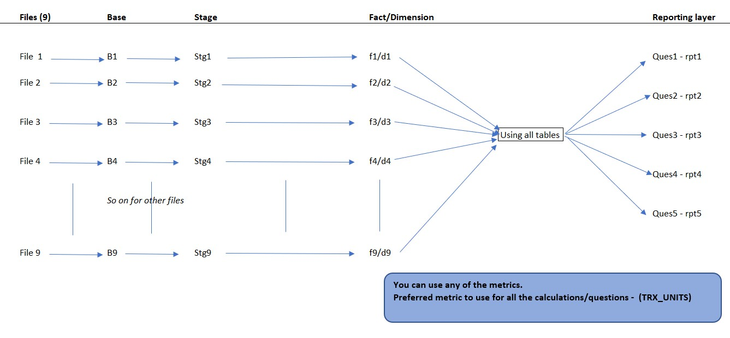
Flow of the data
(Total 7 files)

Slide 17
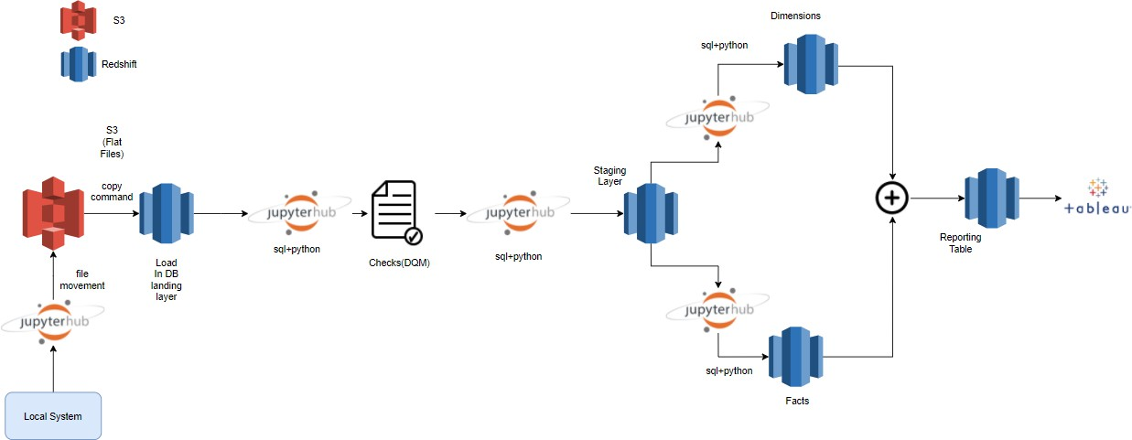
Solution- Data Flow Diagram
Advantages of using python
Knowledge of import packages
Understanding basics of Python
Visualizing data using python via jupyterhub

Slide 18
Steps to be followed
Please use the below files shared over email:
Steps to connect to all the tools
Credentials of all the services
Sample Python code

Slide 19
Steps to be followed (continued)
Connect Tableau & Redshift to fetch the reporting table
OR You can export the data in a file and load it in Tableau
Create Tableau Views / Graphs
Create Tableau dashboard
Final Review & Feedback with Facilitator
Create a PPT presentation

Slide 20
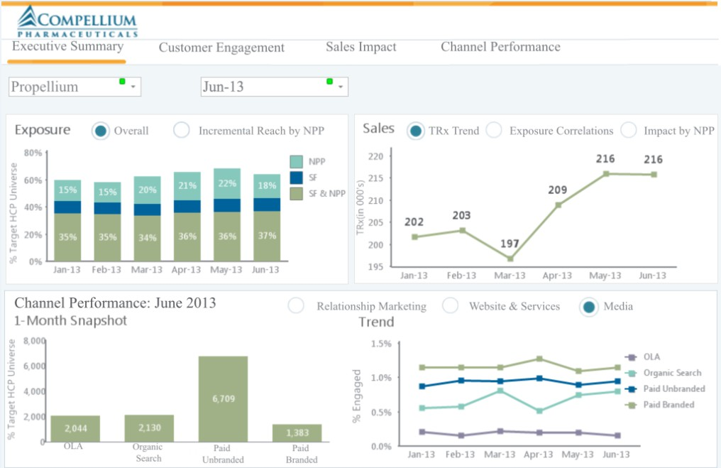
Layout view of Dashboard
Sample

Slide 21
Appendix

